Slide 1
PowerShell 101
The No-Nonsense Beginner’s Guide to PowerShell

Slide 2

Get-Help –Name ‘about_Presenter’
Mike F Robbins
Mississippi PowerShell User Group
PowerShell Conference Book
PowerShell 101: The No-Nonsense Beginner’s Guide
Windows PowerShell TFM 4th Edition
PowerShell Deep Dives
Advanced Category in the 2013 Scripting Games
Learn more about me @ mikefrobbins.com
Notes:
Microsoft MVP on Windows PowerShell
Leader & Co-Founder of Mississippi PowerShell User Group
Author of PowerShell 101: The No-Nonsense Beginner’s Guide
Co-Author of Windows PowerShell TFM 4th Edition
Author of Chapter 6 in the PowerShell Deep Dives book
Winner of the Advanced Category in the 2013 Scripting Games
Learn more about me @ mikefrobbins.com

Slide 3
Write-Output ‘Questions for Audience’
IT Pro’s
Developers
PowerShell
One-Liners
Scripts
Functions
Modules
.NET Framework
Source Control
Unit Testing

Slide 4

Set-Content ‘Information to Cover’
Basics
Discoverability
Objects
Methods
Properties
Pipeline
Filtering
Remoting
Extending PowerShell
Best Practices

Slide 5
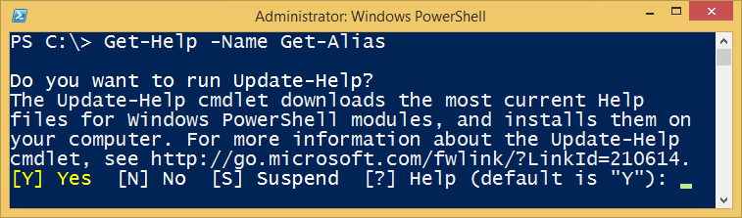
Background Information
PowerShell Commands are called Cmdlets
Cmdlet is pronounced command-let (not CMD-let)
Cmdlets are in the form of singular Verb-Noun commands
Select “Run as Administrator” when opening PowerShell
PowerShell is unable to participate in User Access Control (UAC)
Updatable Help

Slide 6
How Do I Figure Out What the Commands Are?
Core Commands for Discovering How to Use PowerShell
Get-Command
Find what commands are available
Get-Help
Figure out how to use commands
Get-Member
Discover Objects, Properties, and Methods

Slide 7
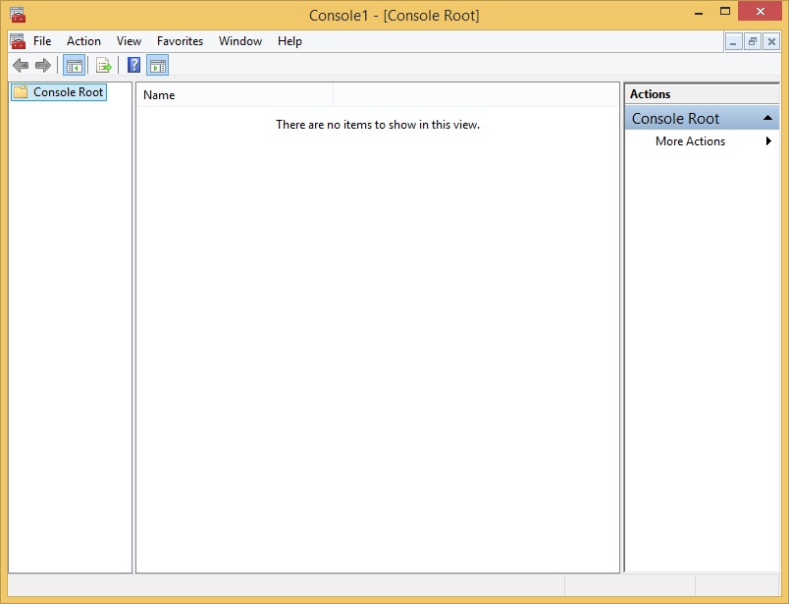
PowerShell is like the Microsoft Management Console (MMC)

Slide 8
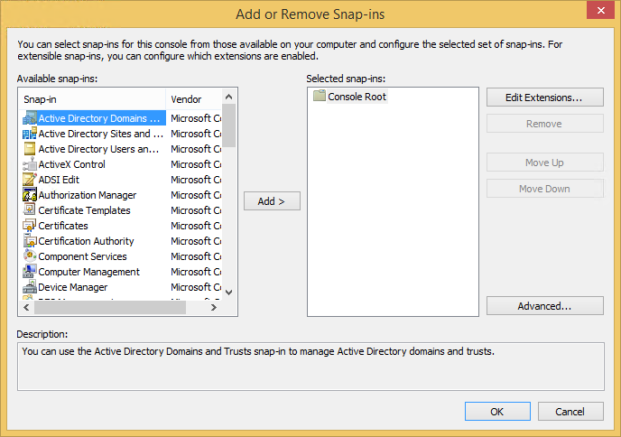
Snap-ins (and Modules) extend its functionality

Slide 9

Start-Process ‘Demo’
Demo Code: github.com/mikefrobbins/Presentations

Slide 10

Book –Name ‘PowerShell 101’
leanpub.com/powershell101

Slide 11
Select-Object –Property ‘Resources’
PowerShell Documentation
PowerShell Best Practices and Style Guide
PowerShell.org
Planet PowerShell
User Groups
PowerShell Community Videos
Twitter
Slack
PSKoans (PowerShell Koans)

Slide 12




Get-Contact –Identity ‘Presenter’
Blog: mikefrobbins.com (or MrPowerShell.com)
Twitter: @mikefrobbins
LinkedIn: www.linkedin.com/in/mikefrobbins
E-Mail: See mikefrobbins.com/about/
User Group: mspsug.com (or MsPowerShell.com)

